Slide 1





TEAM 04
MAX-DEAL
STRATEGIES TO ENHANCE YOUR ONLINE STORE'S PERFORMANCE
Presented By :
Yang Zhihan DC127992
Liang Linda DC126331
Bu Yanan DC228162
Melina Wang DC227485

Slide 2



TABLE OF CONTENT
1
INTRODUCTION
2
SYSTEM DESIGN
3
SYSTEM WALKTHROUGH
team 04
max-deal

Slide 3





INTRODUCTION
Application Domain
An interactive e-commerce platform designed to provide seamless online shopping experiences for global consumers
Functions & Descriptions
MaxDeal is a platform to develop a full-stack e-commerce platform that enables users to login in the system, browse products, and complete purchases.
Target Users: Ordinary consumers
Technologies
Front-end: HTML + CSS + JS
Back-end: PHP + MySQL
Giggling Platypus Co
www.reallygreatsite.com

Slide 4





INTRO/LIST OF SERVICES
User Account Management
Password Recovery System
Product Browsing and Categorization
Product Search Functionality
Order Placement with Delivery Options
Order History and Tracking
User Settings and Account Management
Responsive Web Design for Multiple Devices
Account Security (Password Change, Email Updates)
Giggling Platypus Co
www.reallygreatsite.com

Slide 5

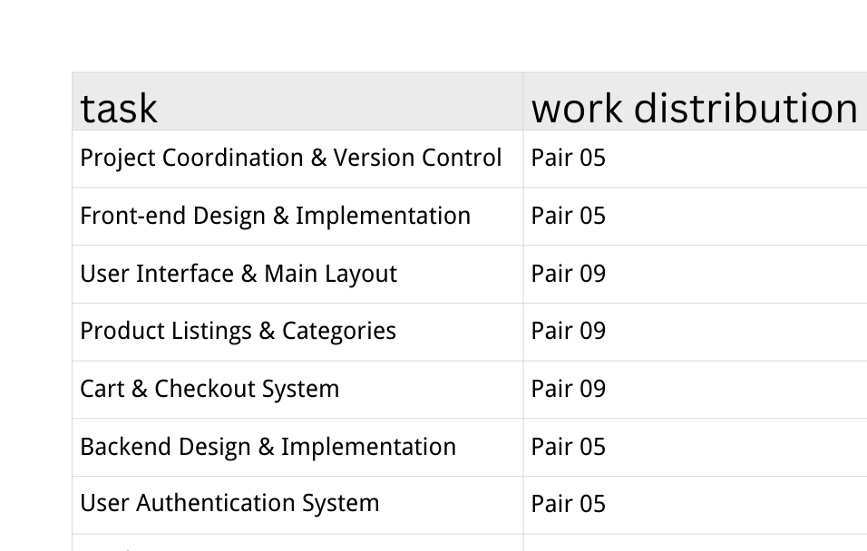
INTRO/LIST OF SERVICES
www.reallygreatsite.com

Slide 6

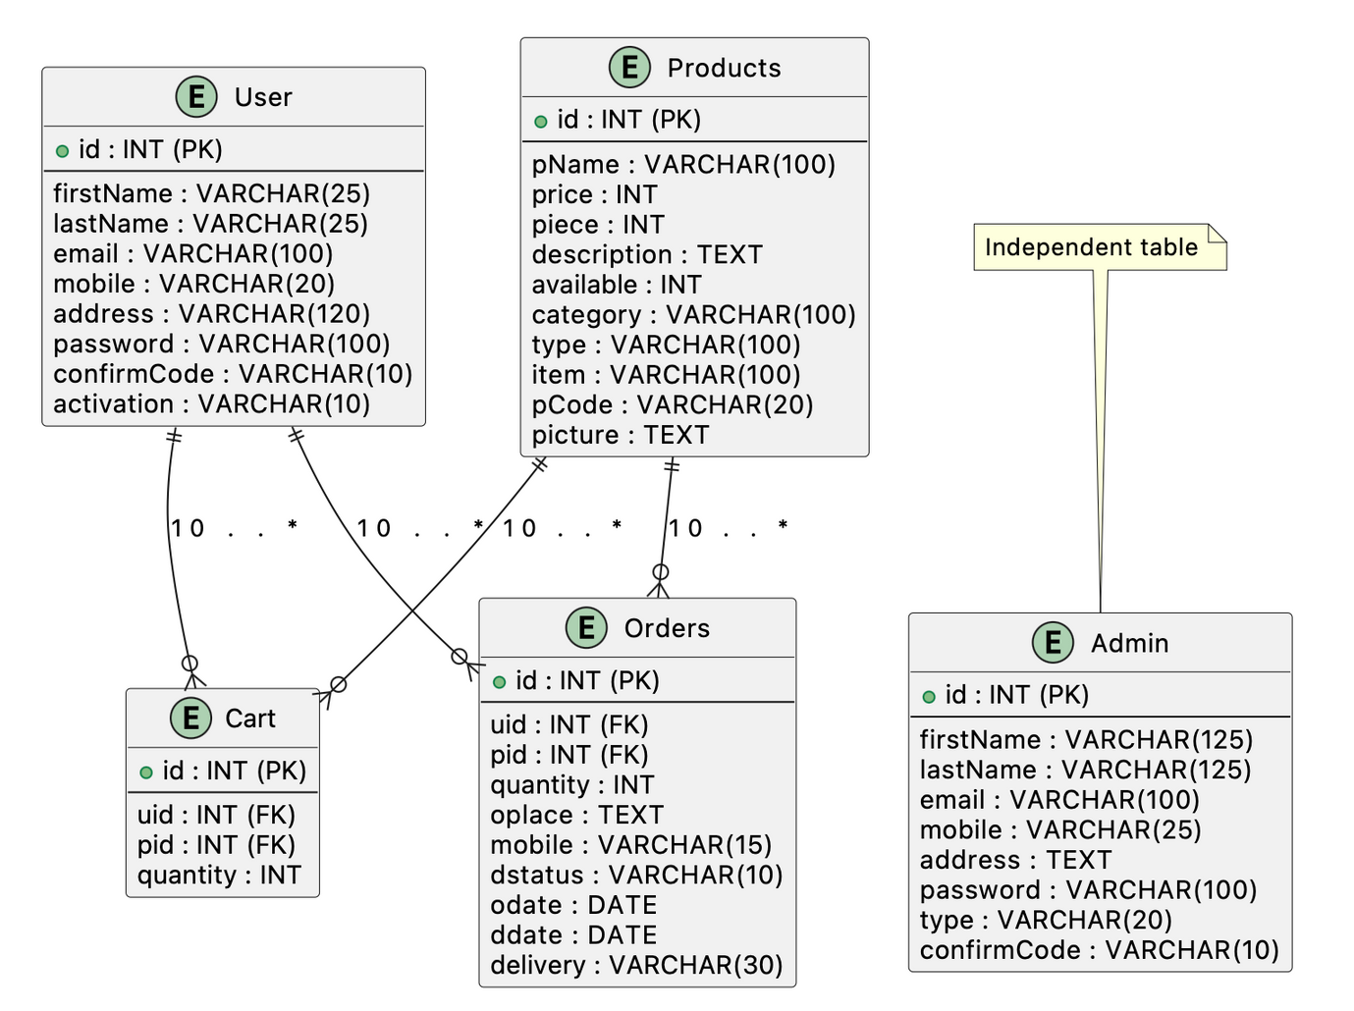
SYSTEM DESIGN/ DATABASE
Database: grocery
www.reallygreatsite.com

Slide 7
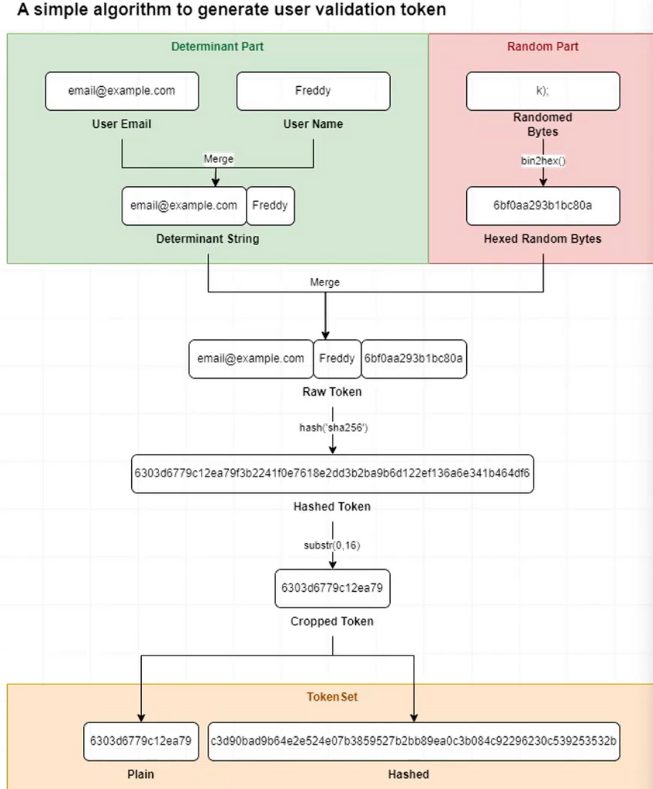
SYSTEM DESIGN/ TOKEN
Token validation is used to verify user's integrity
Anytime a verification is needed, a new usertoken will be generated and sent to the user'semail account.
Randomization: Random 6 bytes
Token generated at different time will be differenteven if the user email and user name are same.
TokenSet:
Plain: Plain token to be sent to user email.
Hashed: To store in the database.

Slide 8


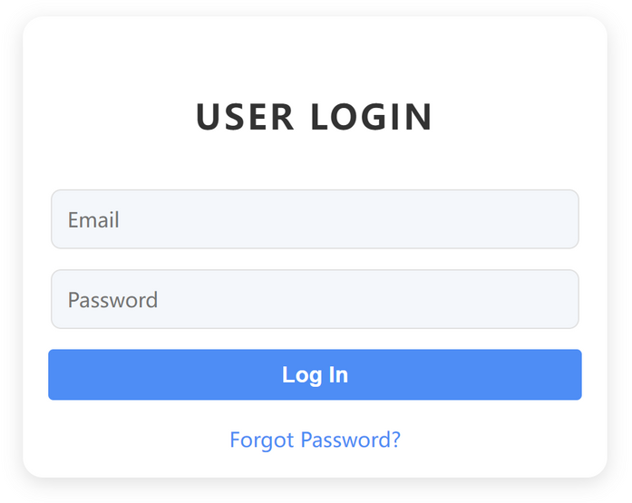
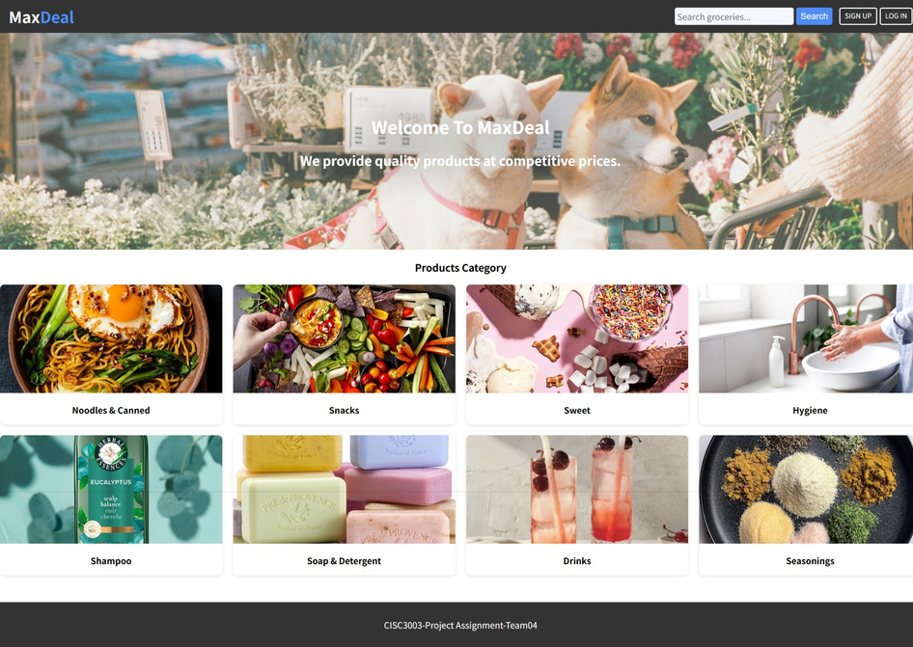
SYSTEM DESIGN/USER INTERFACE
Unified Design Language:
Unified Color Set and Variances
Unified Button Styles
Card View
Google Poppins Font
Responsive Design
Web: Rounded Card, Grid View
Mobile: Sharp Corner Card, List View

Slide 9



SYSTEM DESIGN/USER INTERFACE/RESPONSE

Slide 10
SYSTEM WALKTHROUGH/SHOWCASE 1
Showcase 1: Signup, Login in and Index
Presenters:
Pair 05 | Melina Wang | DC227485
Pair 05 | Bu Yanan | DC228162

Slide 11
SYSTEM WALKTHROUGH/SHOWCASE 2
Showcase 2: Product Detail, Database, Cart
Presenters:
Pair 09 | Yang Zhihan | DC127992
Pair 09 | Liang Linda | DC126331

Slide 12

THANK YOU

